Slide 1

NADIMPALLI SATYANARAYANA RAJU
INSTITUTE OF TECHNOLOGY
(AUTONOMOUS)
(Approved by AICET, New Delhi & Permanently Affiliated to JNTU, Gurajada Vizianagaram)
Recognized under Section 2(f) & 12(B) of the UGC Act, 1956| Accredited by NAAC ‘A’ Grade
Black Zone detection Using GPS in
Machine Learning
BY
NAME:NAKKINA LALITHA KAVYA
COURSE: MCA(2024-2026)
ROLLNO:24NU1F0048
PROJECT GUIDE:
MR. K. RAMA KRISHNA
ASSOCIATE PROFESSOR
1

Slide 2
Contents
  ABSTRACT
  FUNCTIONAL REUIREMENTS
  NON - FUNCTIONAL REUIREMENTS
  USE CASE DIAGRAM
  SEQUENCE DIAGRAM
  ACTIVITY DIAGRAM
  DATABASE DESIGN
  CONCLUSION

Slide 3
ABSTRACT
Road accidents are a leading cause of death and injury worldwide, often occurring repeatedly in specific high-risk zones known as Black Spots. This project aims to develop an intelligent Black Spot Prediction System that uses Artificial Intelligence (AI) and Global Positioning System (GPS) technologies to enhance road safety by identifying and predicting accident-prone areas in real time.
The system collects historical accident data, analyzes geographical patterns, and applies machine learning algorithms to detect high-risk locations. When a driver enters or approaches a potential Black Spot, the system issues live safety alerts and suggests alternate, safer routes. The integration of real-time GPS tracking enables continuous monitoring of the user's location.

Slide 4
FUNCTIONAL REQUIREMENTS
User Registration & Login: Drivers must create an account and log in securely to use the app. Credentials and personal profile data (age, vehicle type, etc.) are stored in a user database. The system should enforce secure authentication (e.g. OAuth 2.0) and encrypt all sensitive data (passwords, GPS coordinates)
Real-Time GPS Tracking & Map Display: The app continuously obtains the driver’s GPS location and displays it on a map interface. For example, a Google Maps API integration can show the vehicle’s position and route in real time. The map should highlight known black spots (accident-prone segments) along or near the planned route.
Black-Spot Alert Generation: The system analyzes both historical accident data and live location to detect when a driver is nearing a high-risk zone. As the driver approaches a black spot, the app issues a real-time warning (visual and/or audio) to allow extra caution. This mirrors existing safety apps that “notify users when they are approaching black spots.
Route Planning and Safe Detours: Drivers can enter a source and destination. The system computes an initial route and then checks it against identified black spots. If the planned route passes near a high-risk area, the system automatically suggests an alternate, safer route to avoid the black spot. Modern GPS systems “dynamically adjust routes based on real-time… conditions” to avoid hazards

Slide 5
NON - FUNCTIONAL REQUIREMENTS
Performance Requirements
The system should generate alerts within 2 seconds when a user enters a black spot zone.
It must support real-time GPS tracking with minimal lag.
The system should handle at least 1000 concurrent users without performance degradation.
Security Requirements
All user data (e.g., login info, location) must be encrypted using SSL/TLS.
Passwords should be securely stored using hashing algorithms.
Admin features must be accessible only via role-based access control (RBAC).
The system must prevent unauthorized access, SQL injection, and data tampering.
Usability Requirements
The UI must be simple, responsive, and user-friendly for both mobile and web platforms.
All map interfaces should be clearly labelled with icons for black spots and safe routes.
Safety alerts should be easy to understand with visual + audio cues.
Scalability Requirements
The system must be designed to scale vertically and horizontally as the number of users increases.
It should support future expansion, like adding new regions, routes, and accident datasets.

Slide 6
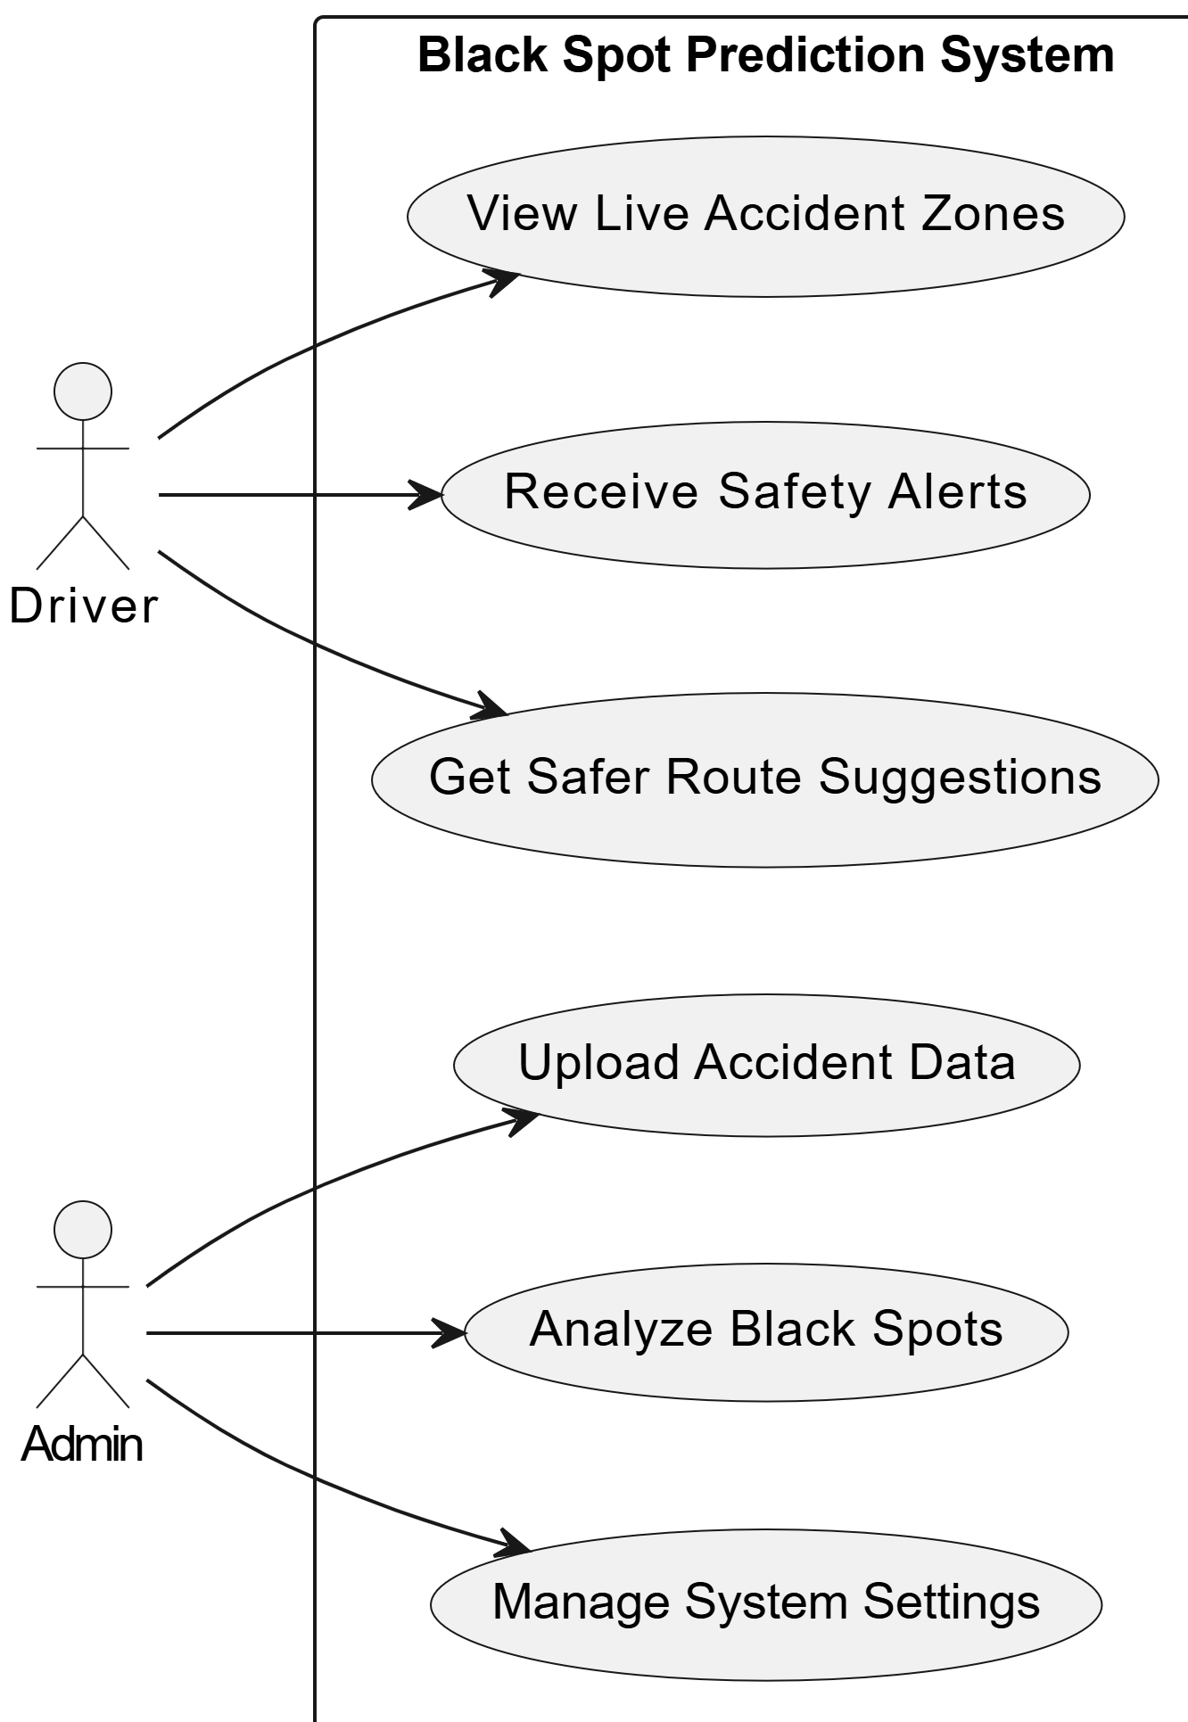
USE CASE DIAGRAM
The Use Case Diagram of the Black Spot Prediction System represents the interactions between different users (actors) and the system itself. It helps identify the main functionalities the system should provide and how users will engage with them. In this project, the primary actors include the Driver and the Admin. The Driver interacts with the system to receive real-time alerts about accident-prone (black spot) areas, based on GPS tracking.

Slide 7
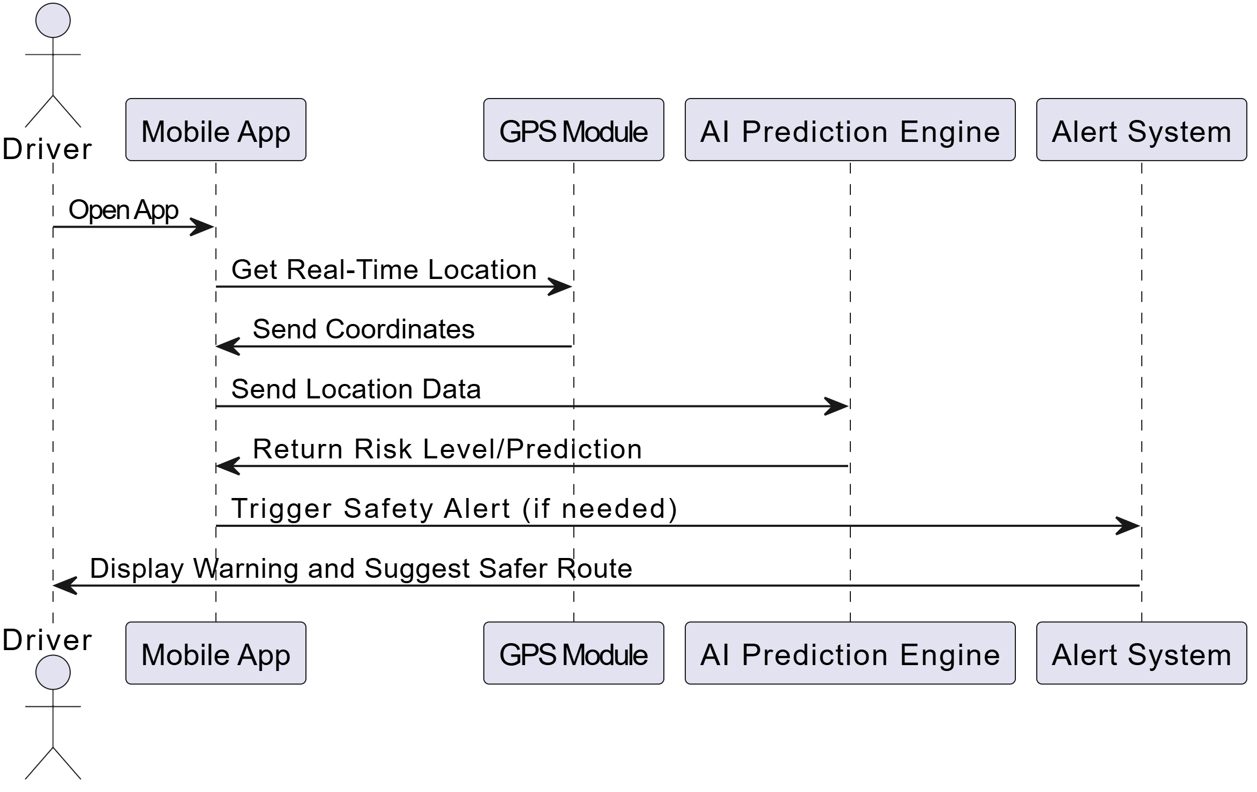
USER SEQUENCE DIAGRAM

Slide 8
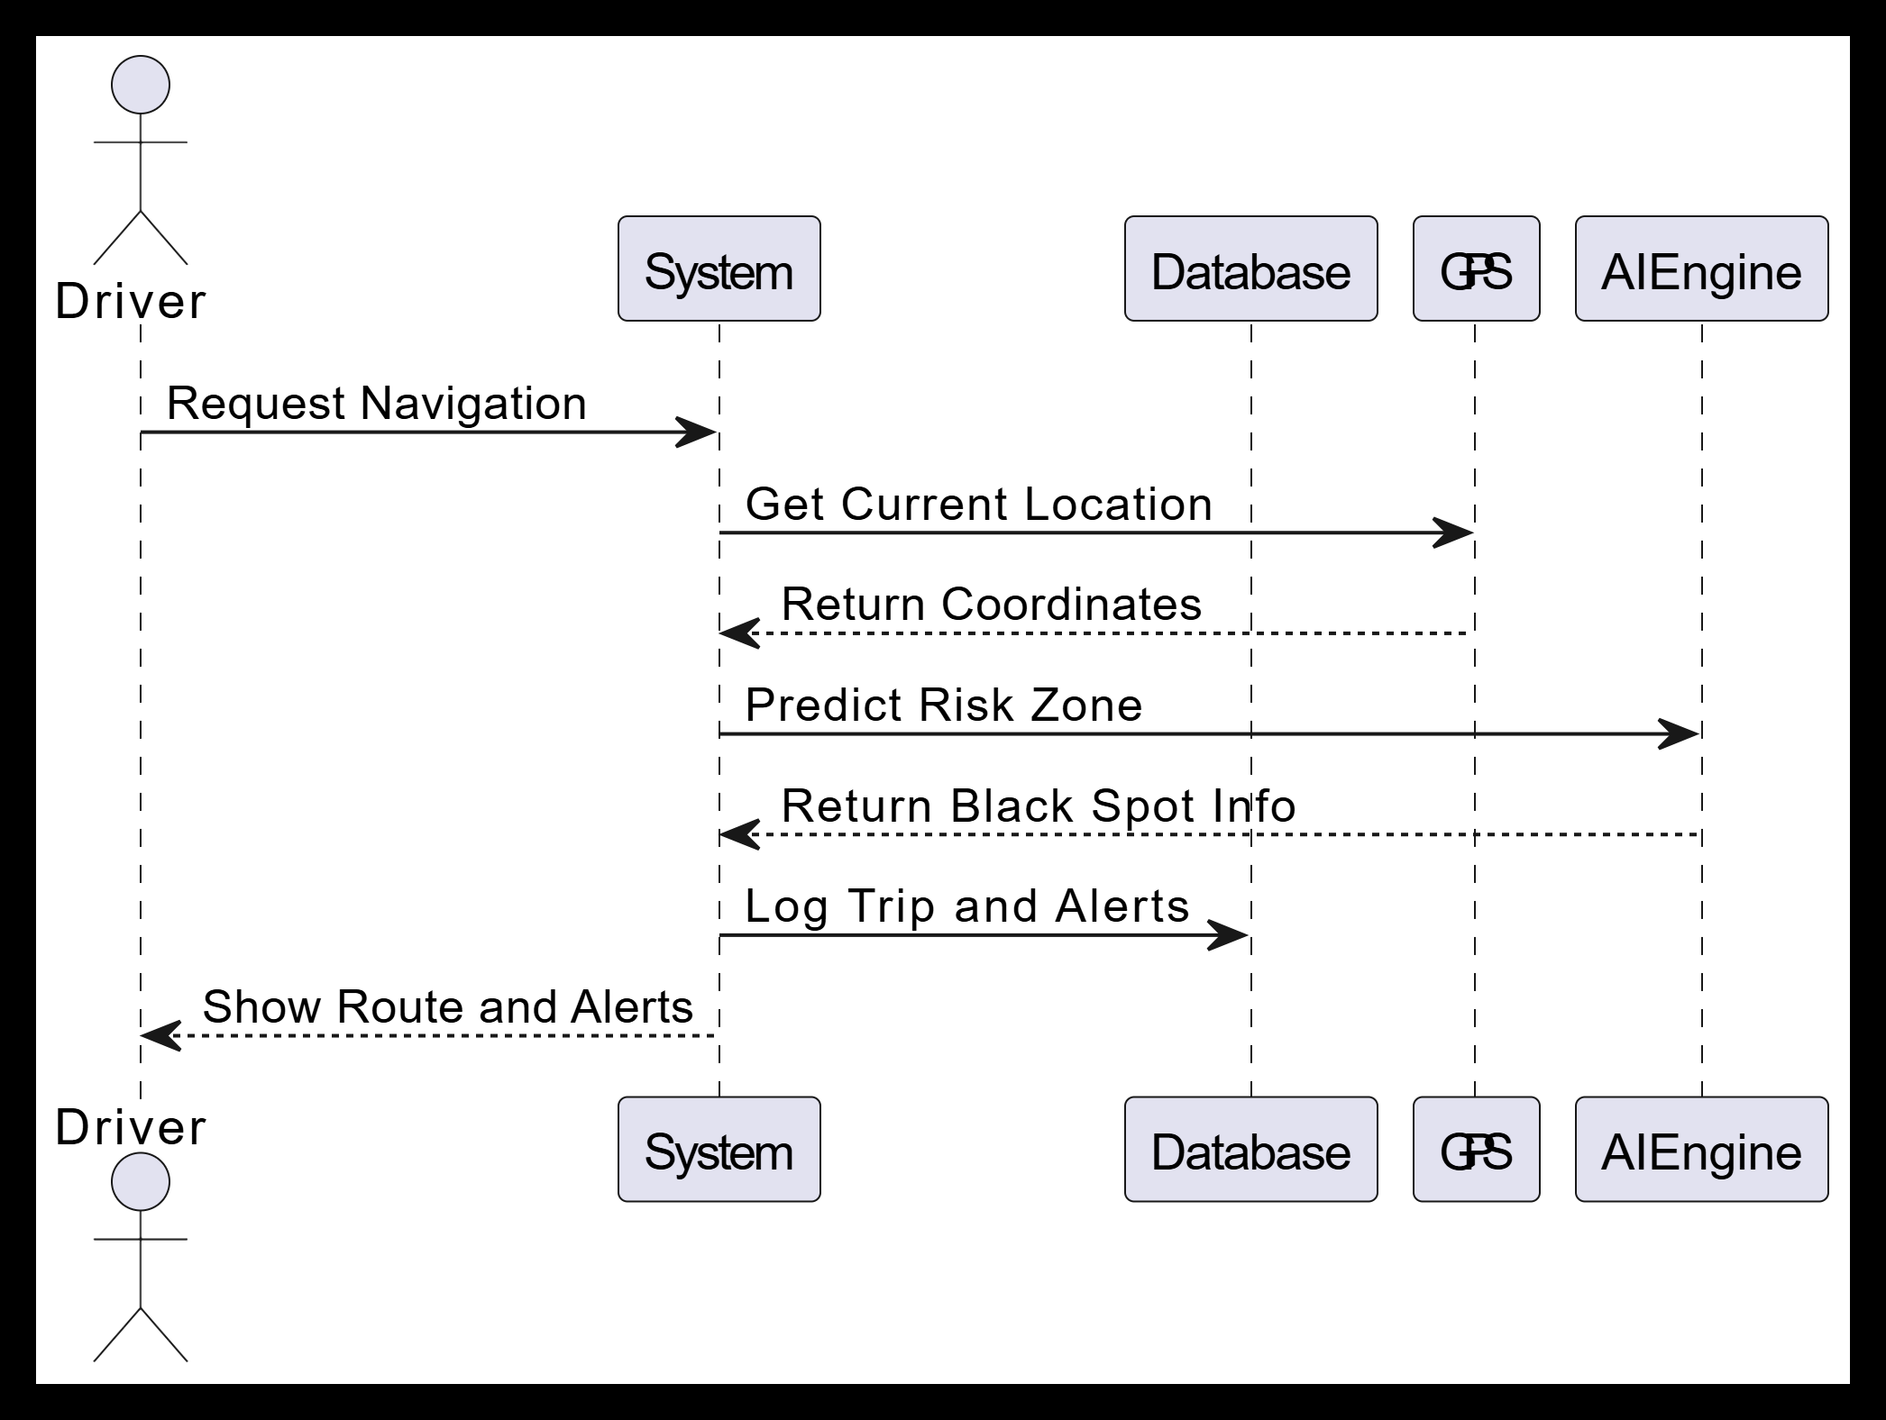
SYSTEM SEQUENCE DIAGRAM

Slide 9
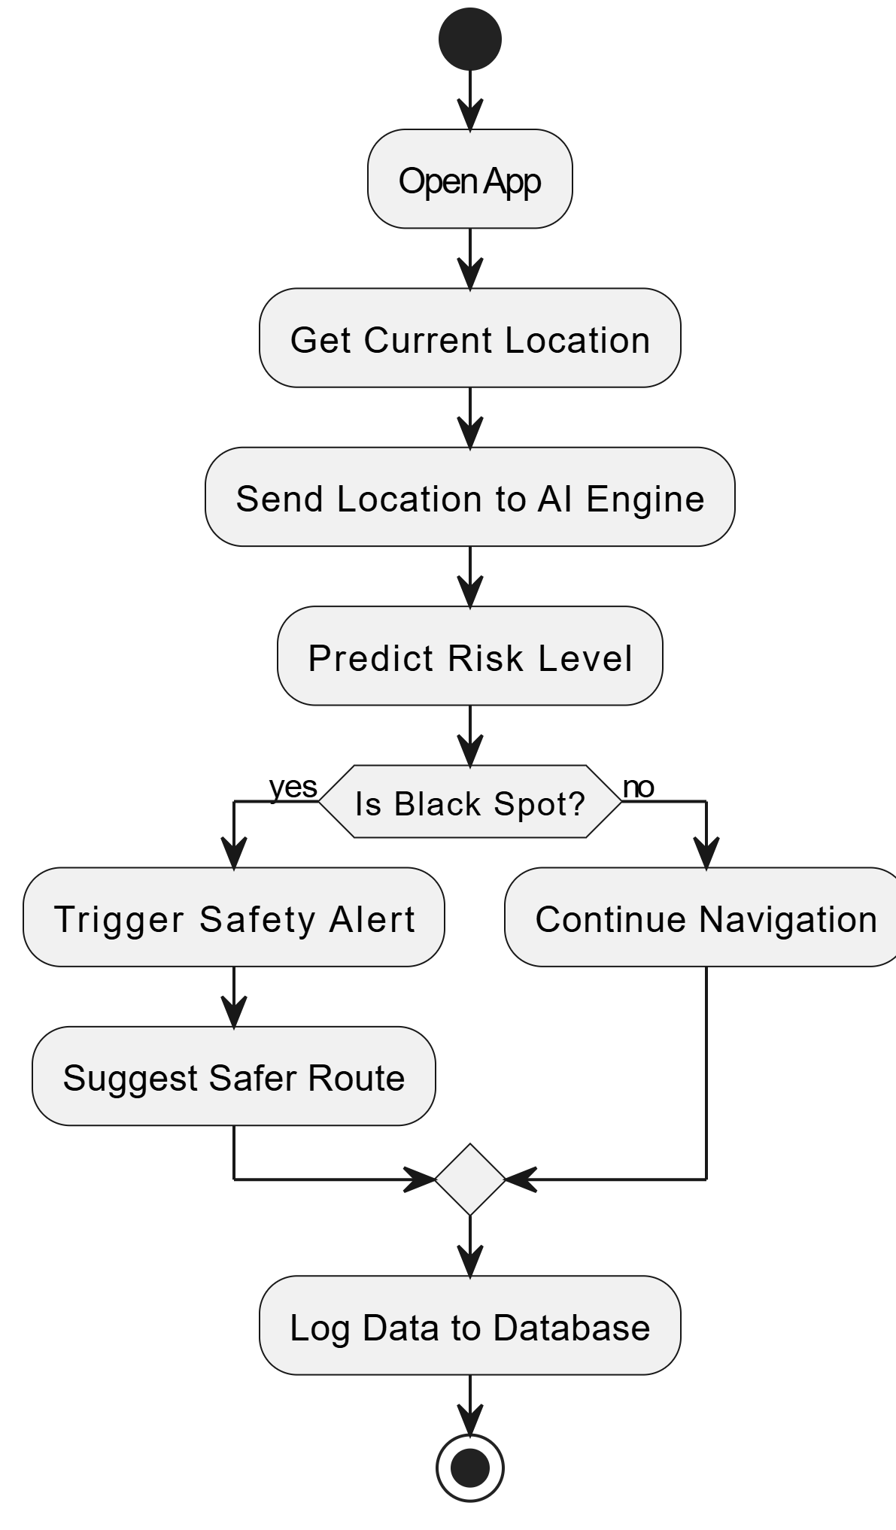
ACTIVITY DIAGRAM
The Activity Diagram of the Black Spot Prediction System represents the workflow and sequence of activities that occur during the system’s operation. It shows how the system behaves in response to user actions and internal processes, using a flowchart-style format. For example, when a Driver logs in, the system fetches their real-time GPS location, checks if they are approaching a black spot, and then generates a safety alert

Slide 10
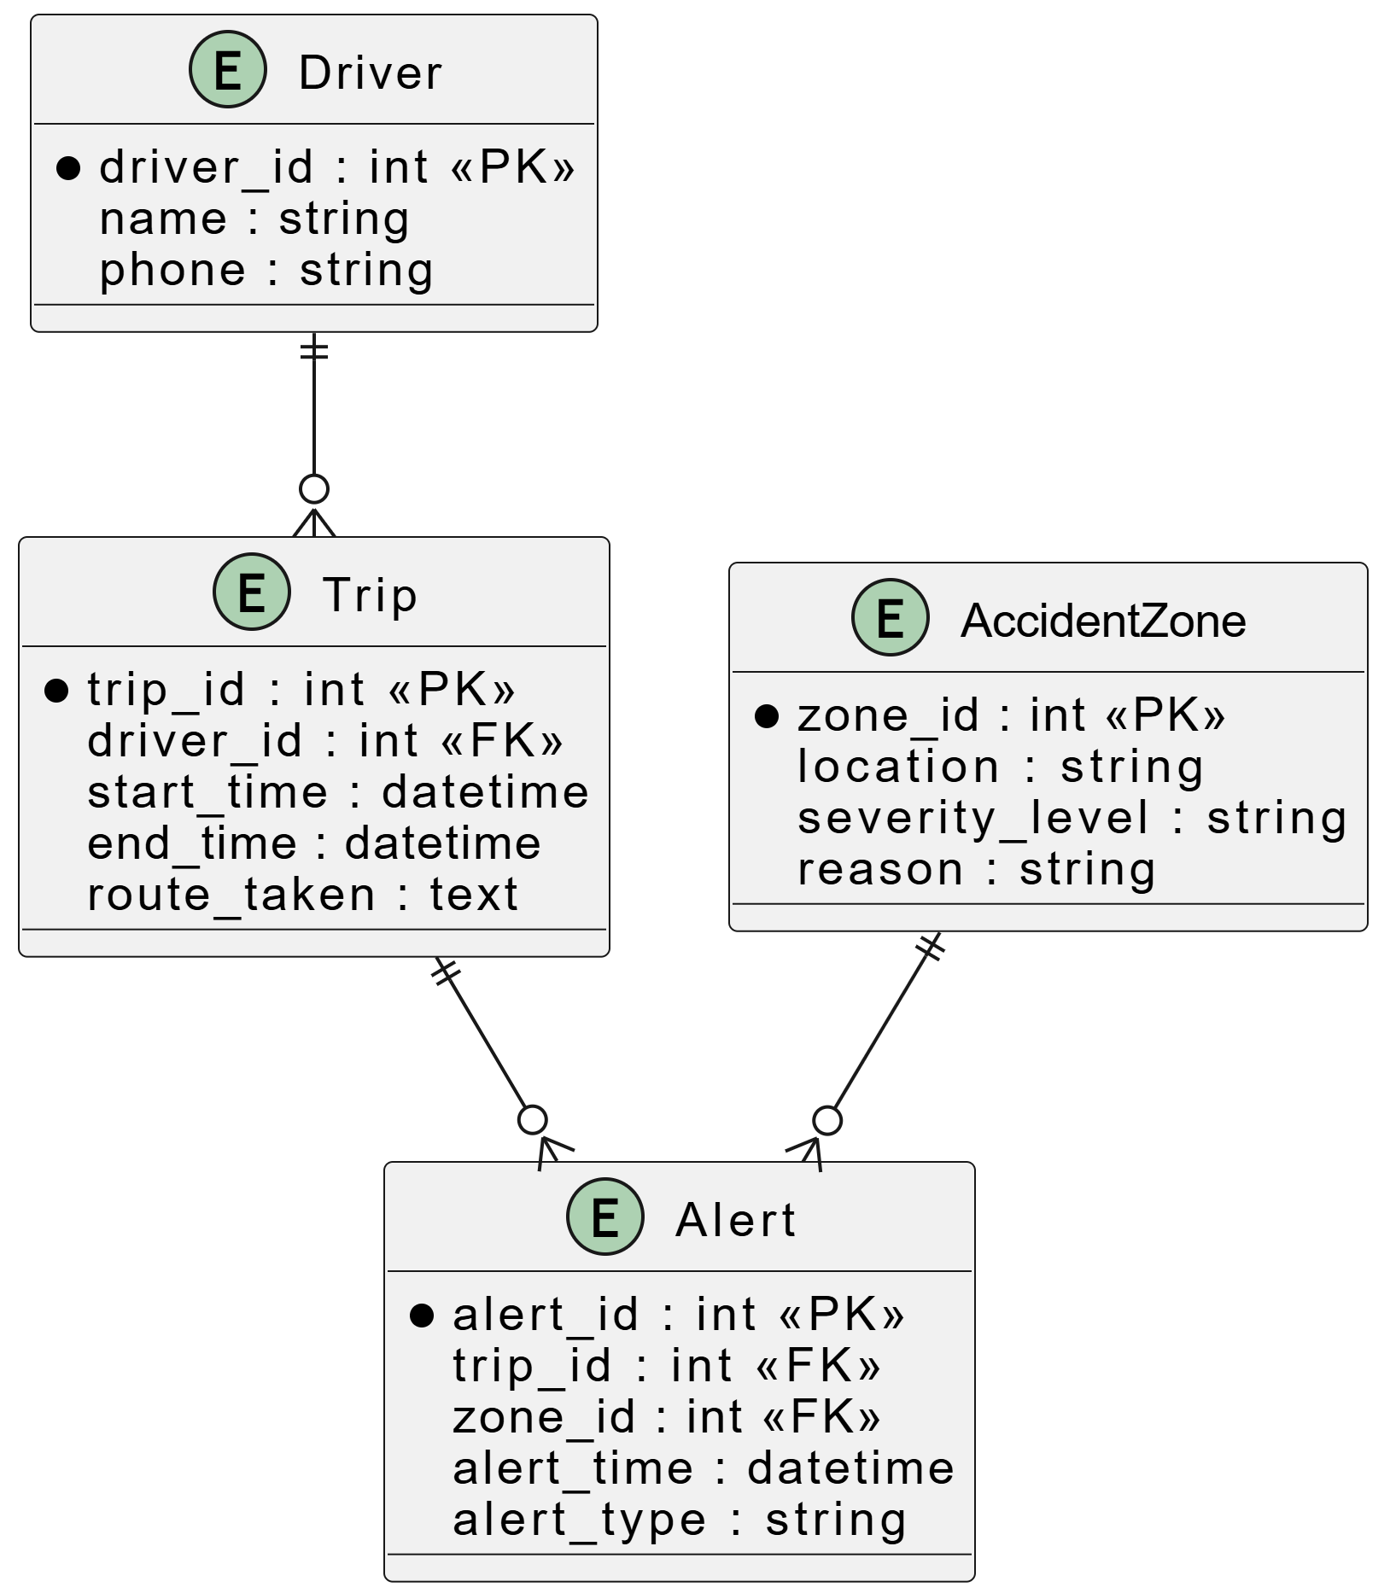
DATABASE DESIGN
The Database Design of the Black Spot Prediction System defines how data is organized, stored, and related within the system. It includes a set of structured tables that hold important information such as user details, location data, accident records, black spot zones, and alerts.

Slide 11
CONCLUSION
The Black Spot Prediction System successfully integrates AI, machine learning, and GPS technology to predict and identify high-risk accident zones, also known as black spots, on roads. By analyzing historical accident data, the system can effectively detect dangerous zones, providing drivers with real-time alerts to enhance road safety. This not only reduces the risk of accidents but also helps authorities improve road infrastructure by critical areas identified by the system.
the Black Spot Prediction System represents a significant advancement in road safety technology. It not only reduces the occurrence of accidents but also improves overall traffic management and infrastructure planning by providing valuable, data-driven insights. This project stands as a proactive step toward creating safer roads and reducing road fatalities globally.

Slide 12
THANK YOU!

